Slide 1
Classifying Consumers on Fruit Spending based on Demographics

Slide 2
Business Goal
Classifying consumers based on their demographics and behaviors for targeted ads and marketing campaigns to increase profit for our Fruit Business in the long run

Slide 3
Dependent Variable
Consumer Class on Fruit Spending (Calculated by average sales and classifying with 0s and 1s)
High Spender = 1
Low Spender = 0

Slide 4
Dataset
Sales dataset that contains transaction data along with consumer details such as income, marital status, presence of children in the household, and the dependent variable Consumer Class.

Slide 5
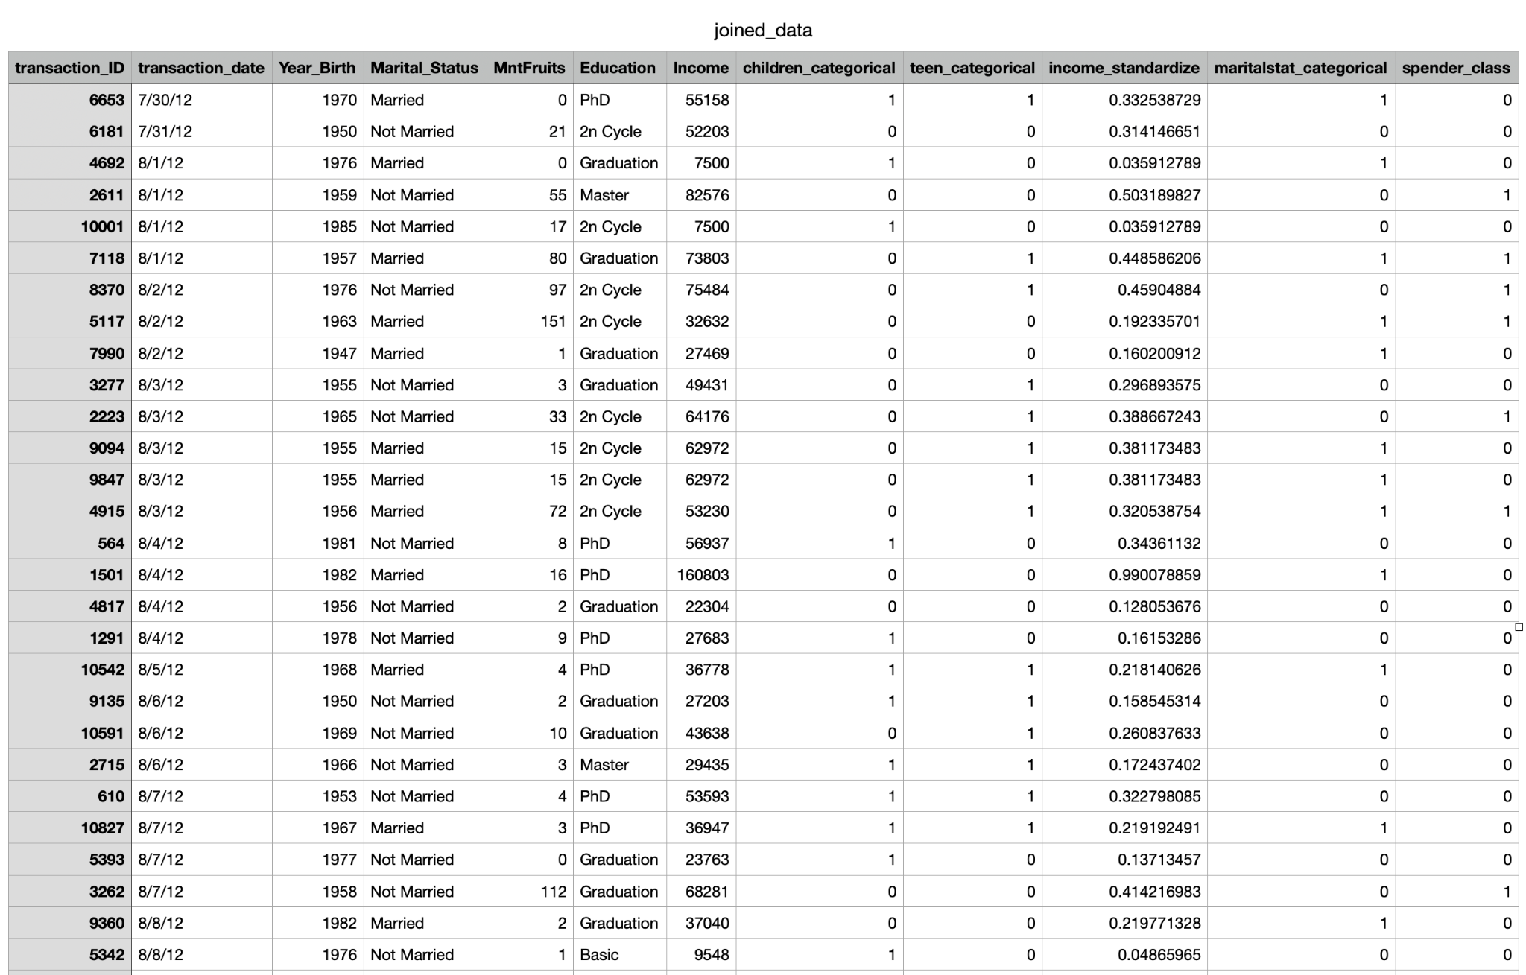
Joined Dataset
Utilized SQL’s full outer join on transaction_id.
Pulled education, income, presence_of_children, presence_of_teens.
Standardized income level and used the 1-and-0 approach for other categorical independent variables.

Slide 6
Neural Network Model

Slide 7
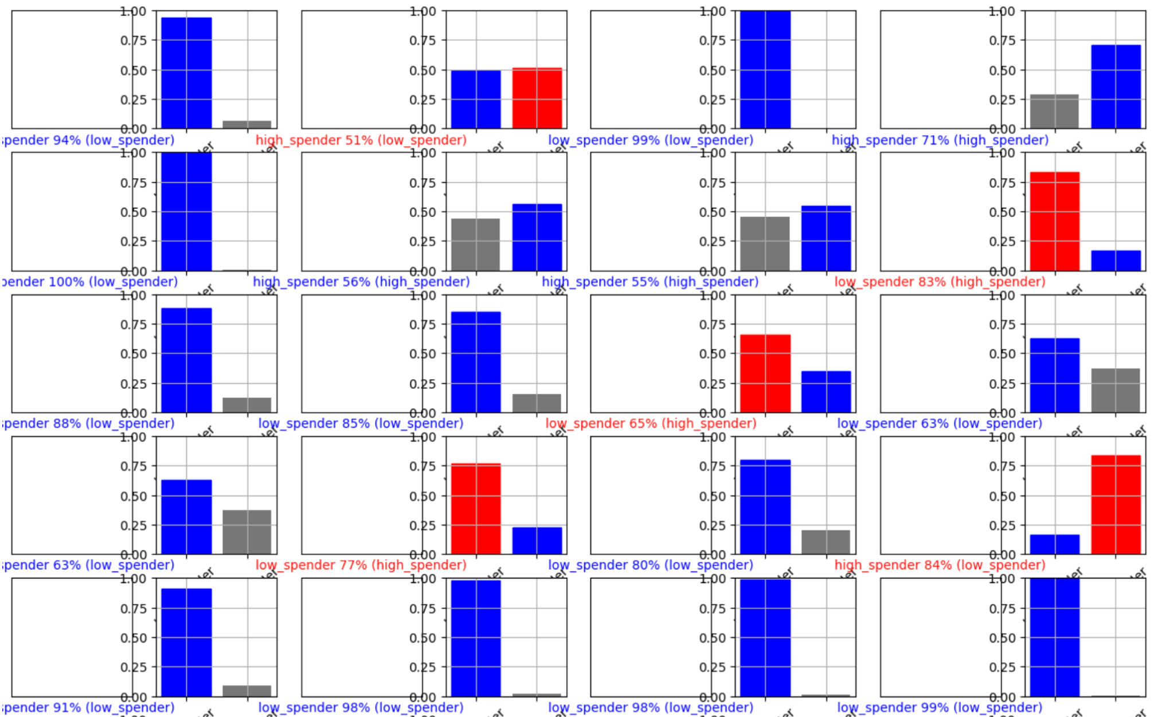
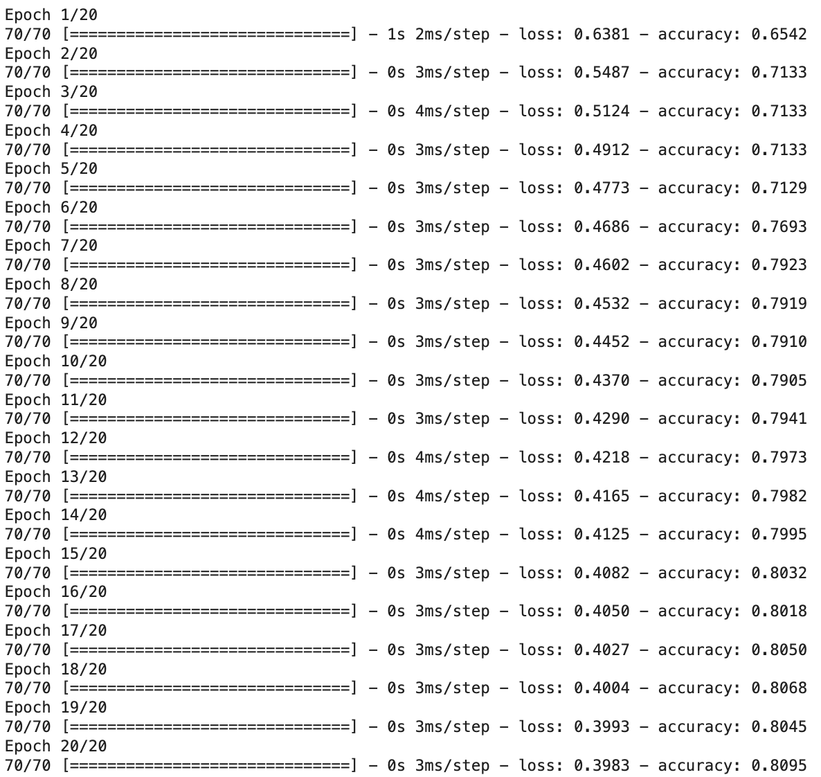
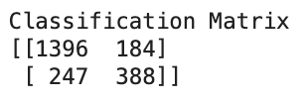
Initial Model
3 Layers of Nodes
20 epochs
Utilizes Adam optimizer
Achieved 80% accuracy without any tuning of the parameters

Slide 8
Hypertuning Our Current Model

Slide 9
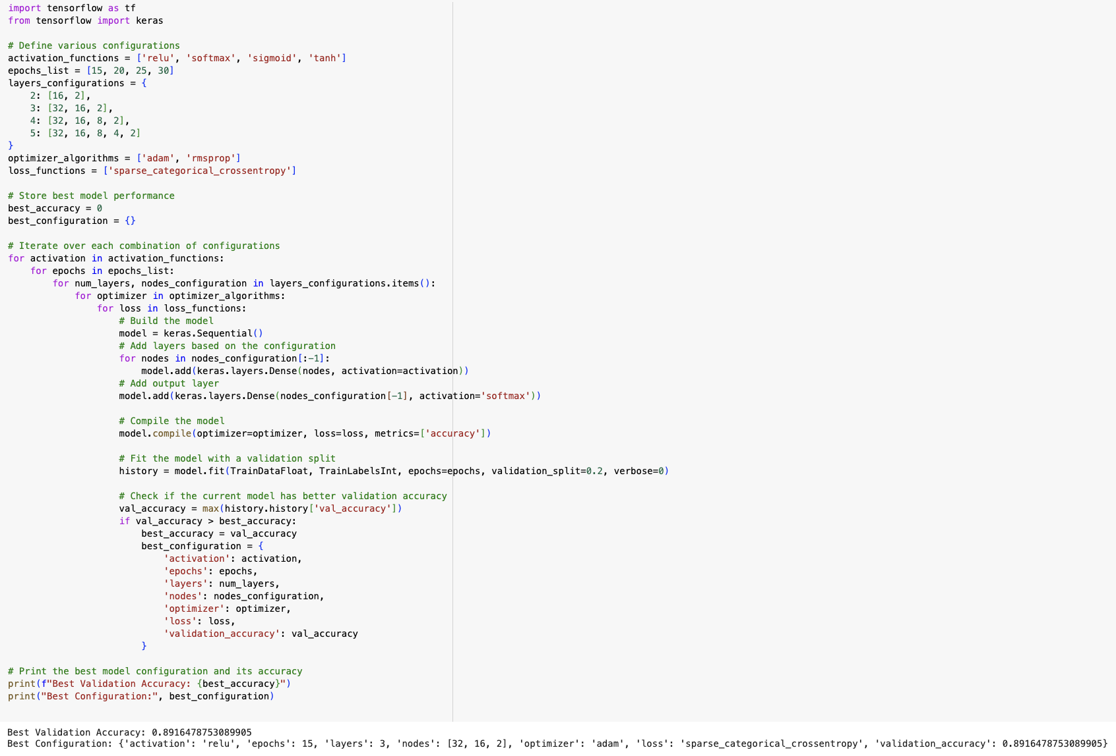
Hypertuned Model
Using KerasTuner to find:
Optimal number of layers
Optimal number of epochs
Optimal optimizer function
Optimal Hyperparameters:
Layers: 3
Epochs: 15
Nodes: [32, 16, 2]
Optimizer Function: Adam
Loss function: Sparse categorical entropy
Validation accuracy: Achieved 90% accuracy after tuning hyperparameters

Slide 10
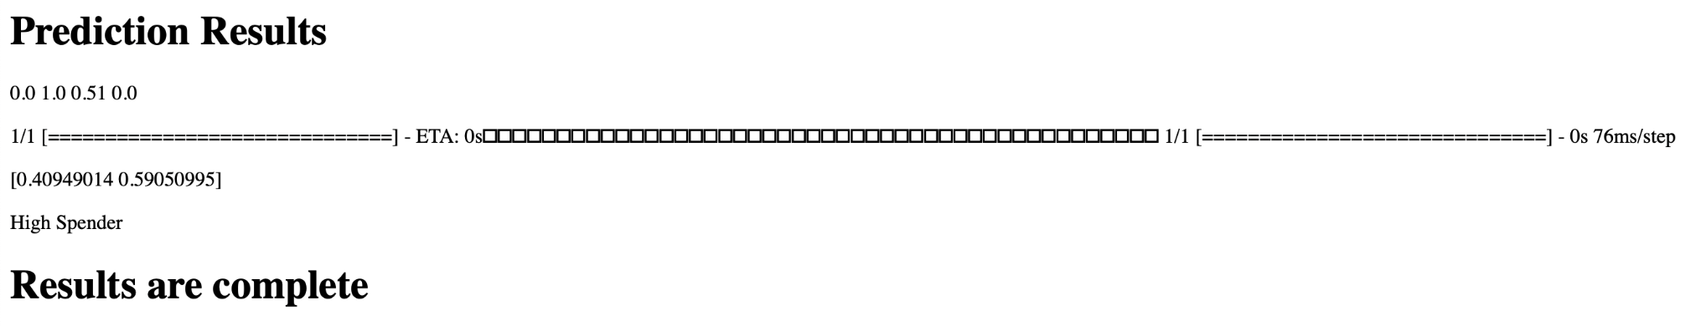
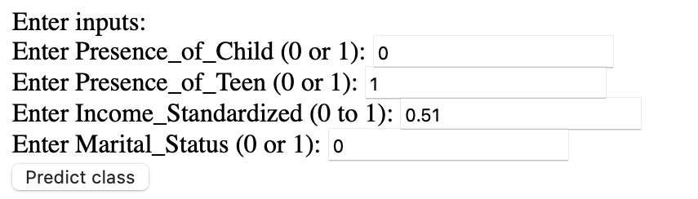
Results
Hypertuned Model
Using KerasTuner to find:
Optimal number of layers
Optimal number of epochs
Optimal optimizer function
Optimal Hyperparameters:
Layers: 3
Epochs: 15
Nodes: [32, 16, 2]
Optimizer Function: Adam
Loss function: Sparse categorical entropy
Validation accuracy: Achieved 90% accuracy after tuning hyperparameters

Slide 11
Live Demo

Slide 12
CONCLUSION
https://34.28.86.238:8000
1. Income is a huge contributor to our classification and is justified to due to larger propensity of consumption. Interestingly, if a household has a child present, it also increases the likelihood that a consumer would spend more on fruits as well. We will need to further investigate the relationships between each predictor to the dependent variable.
3. Given that the relationship between our predictors to the dependent variable seems to be linear, we will have to further investigate classification models that better fit the nature of our data. We would also like to expand our data to include more observations and possibly other store locations.
2. Optimized parameters to find the best number of layers, epochs, and optimizer function (Adam) that resulted in a 10% increase in accuracy from our initial model. Future projects could look into XGBoost classification to determine if it could be a better model for our data.
4. Given the positive correlation between income and the presence of children with fruit expenditure, we anticipate a similar trend in spending on complementary foods like wine, soft cheeses, and nuts. Expanding our data to include expenditure figures on these items would allow us to explore this hypothesis further.

